Slide 1
Business Expansion to Commercial Air Travel
Group 2 Assouma, Riena Michelle Dela Peña , Keesha Duarte, Cherisse Aryana Mari
Lozano, Milagros May Sy, Alaine Denise

Slide 2

Stakeholder Prompt
We are an offshore conglomerate, interested in expanding our business to include commercial air travel. We want to know everything you can tell us ahead of time that will help us succeed in this endeavor. Tell us about competition, business opportunities, what we should expect in terms of demand and volume, etc.

Slide 3

Business Problem
What factors should the offshore conglomerate consider in expanding their business to commercial air travel?

Slide 4
Factors
Trend
Seasonality
Supply and Demand
Busiest Departure Areas
Top Carrier Competitors

Slide 5
TREND

Slide 6
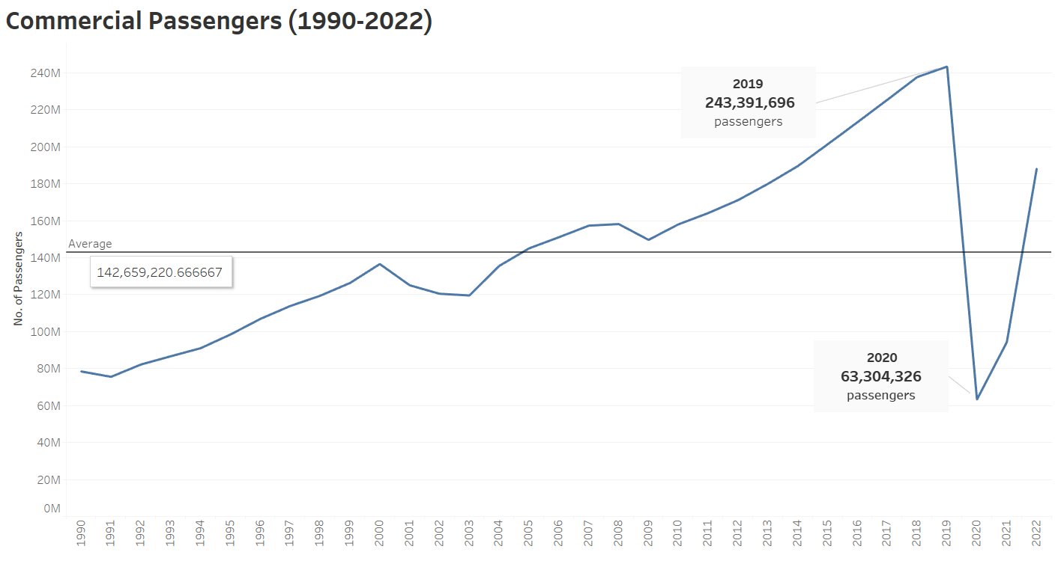
On average, 143 million passengers were flying commercially per year in 1990-2022. The number of passengers peaked up to 243 million but also dropped as low as 63 million.

Slide 7
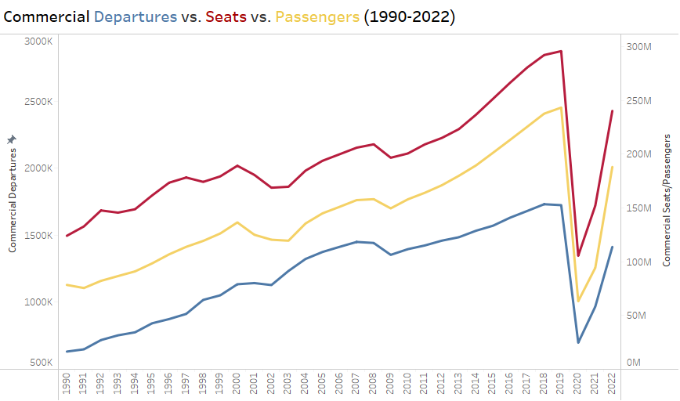
The number of departures, seats and passengers of the commercial flights per year had an identical rising trend despite some falls.

Slide 8
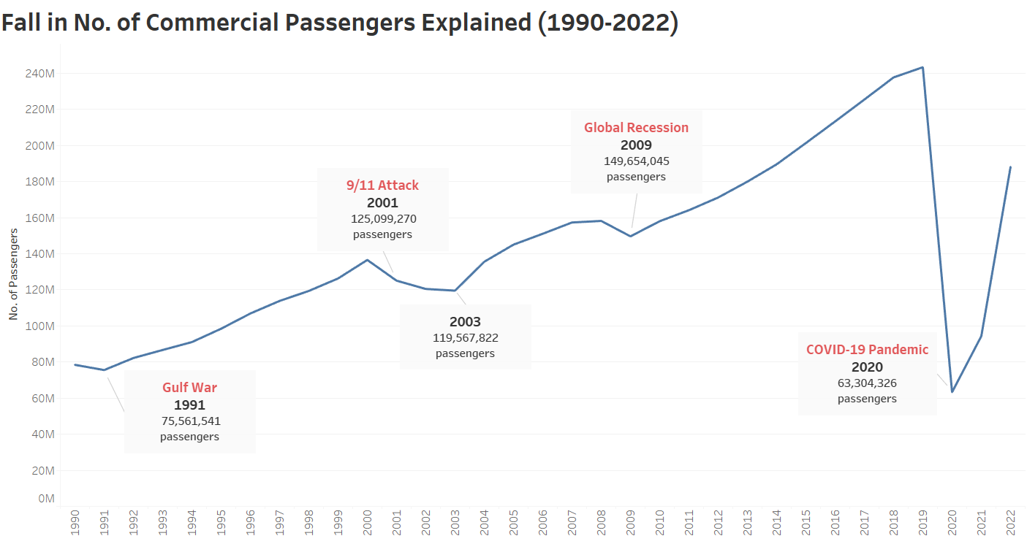
The greatest hit was during the pandemic on 2020 when the number of commercial passengers dropped by 74% from 2019, but it increased by 200% from 2020 to 2022.
References:
https://www.nytimes.com/1991/01/27/travel/travel-advisory-gulf-war-leads-to-a-30-drop-in-world-travel.html
https://www.cnbc.com/2021/09/11/how-9/11-forever-changed-air-travel.html
https://money.cnn.com/2010/01/20/news/economy/air_traffic_2009/index.htm
https://www.wsj.com/articles/how-coronavirus-has-affected-air-travel-and-what-it-could-mean-for-you-11604968356

Slide 9
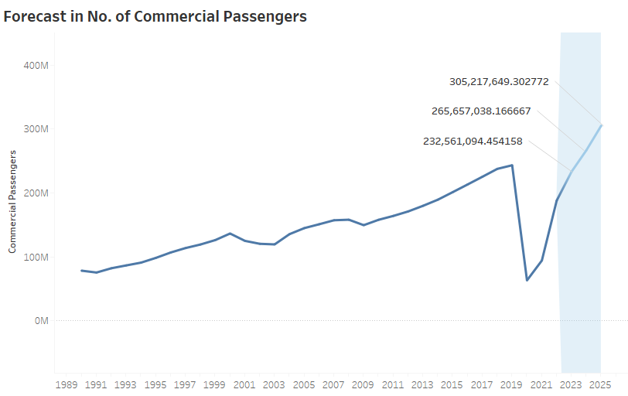

Number of commercial passengers is forecasted to keep rising from 2023 up to 305 million by 2025.
Notes:
MASE = 0.45 (forecast model is better than the naive forecast and reflects only 45% of the error of the naive forecast)

Slide 10
SEASONALITY

Slide 11
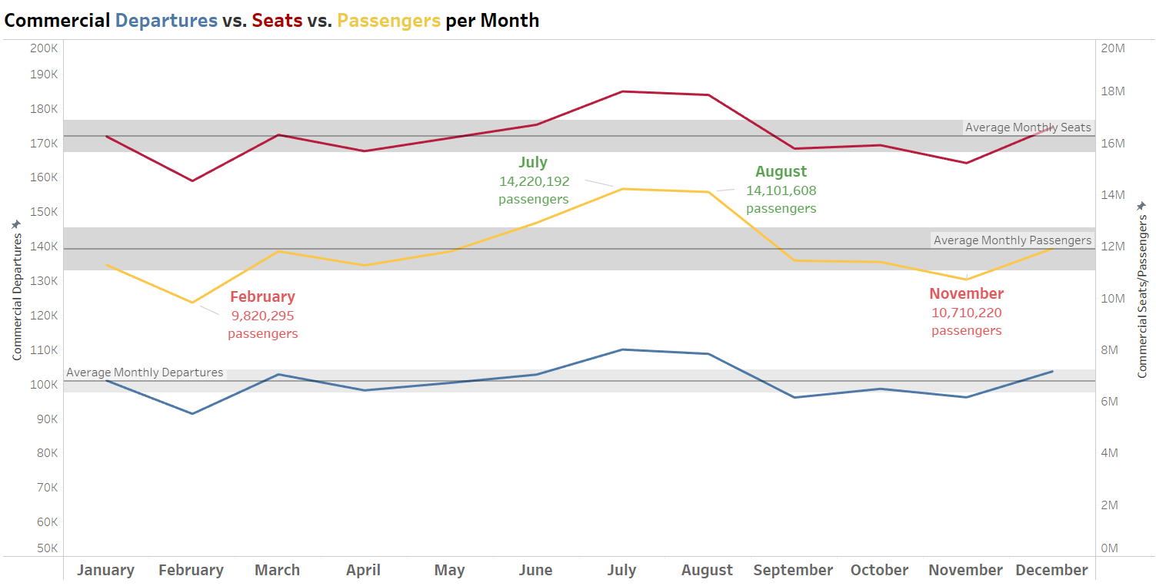
Average of 12 million passengers were flying monthly commercially on 1990-2022.
July to August were the Peak Months with around 14 million average monthly passengers.
February and November were the Lean Months with 9.8 million and 10.7 million average
monthly passengers, respectively.

Slide 12
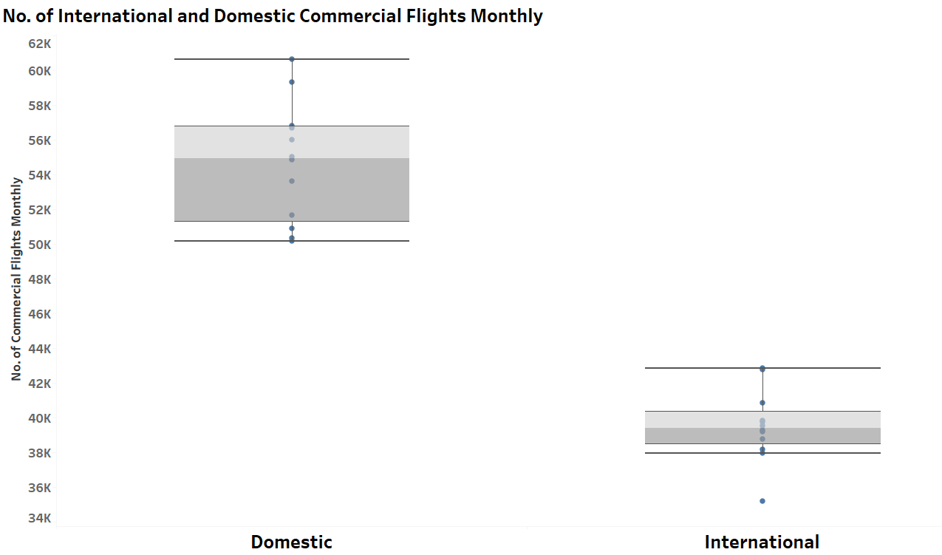


No. of Domestic and International Commercial Flights per Month
There were around 55,000 domestic and 39,000 international commercial flights departing monthly in 1990-2022.
Monthly Domestic Flights
Peak Months: 60,700 (1,957 daily)
Lean Months: 50,200 (1,672 daily)
Monthly International Flights
Peak Months: 42,900 (1,429 daily)
Lean Months: 38,000 (1,265 daily)
Domestic
International

Slide 13
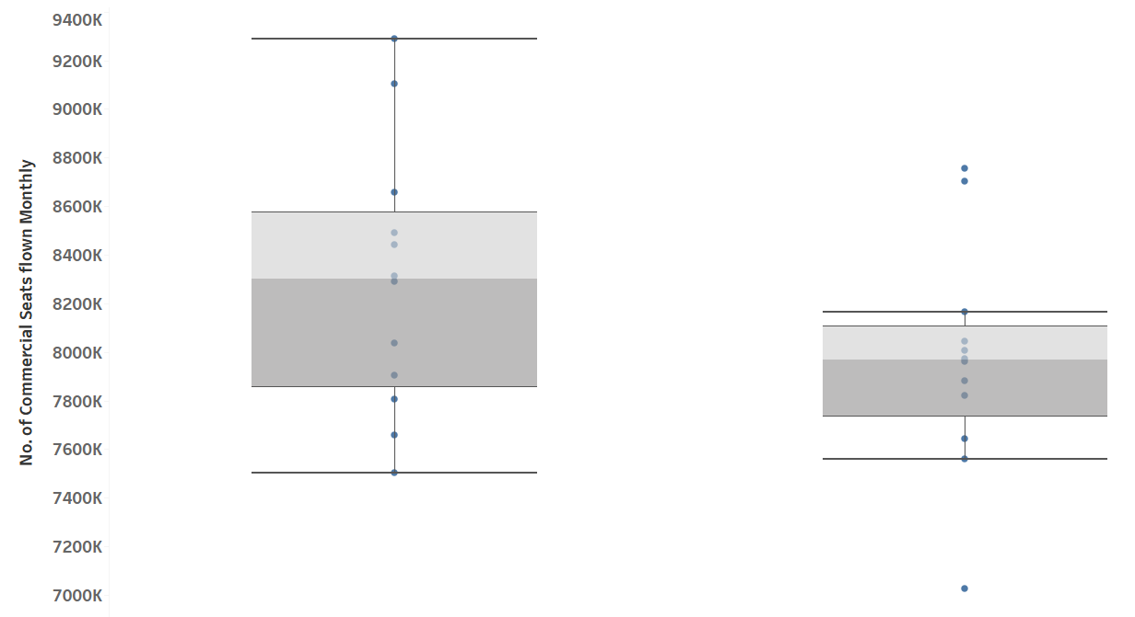


No. of Domestic and International Seats flown per Month
There were around 8.3 million domestic and 8 million international commercial seats being flown monthly in 1990-2022.
Monthly Domestic Seats
Peak Months: 9.3 million (300,000 daily)
Lean Months: 7.5 million (250,000 daily)
Monthly International Seats
Peak Months: 8.2 million (263,000 daily)
Lean Months: 7.6 million (252,000 daily)
Domestic
International

Slide 14
SUPPLY AND
DEMAND

Slide 15
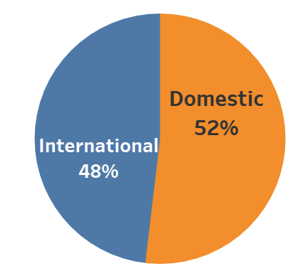
52% of the total number of passengers from 1990-2022 flew with domestic while 48% flew with international commercial flights.
Percentage of Average Annual No. of International and Domestic Commercial Flight Passengers (1990-2022)

Slide 16
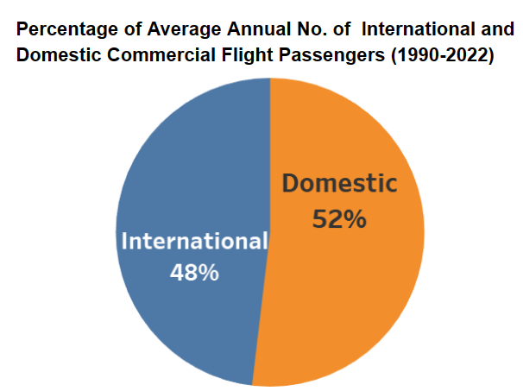


Passengers’ demand for domestic was 4% more
than international flights in its 1990-2022 annual average.
On average, domestic flew around 40% more commercial
flights than international.
Domestic had an average of 150 seating capacity per flight,
while international had around 200 seats.

Slide 17
BUSIEST DEPARTURE
AREAS

Slide 18
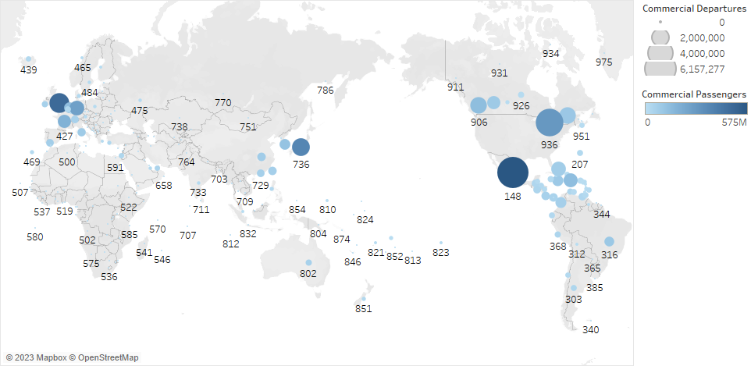
Top world areas with the highest number of departures and passengers from 1990 to 2022
148 - Mexico (Middle America)
493 - UK (Europe)
736 - Japan (Far East)
936 - Ontario (Canada/Greenland)
429 - Germany (Europe)
Notes:
Size of bubbles indicates number of departures. And the intensity of color indicates number of passengers. The area with highest number of departures and passengers from 1990-2022 is id number 148 which is mexico in middle america

Slide 19
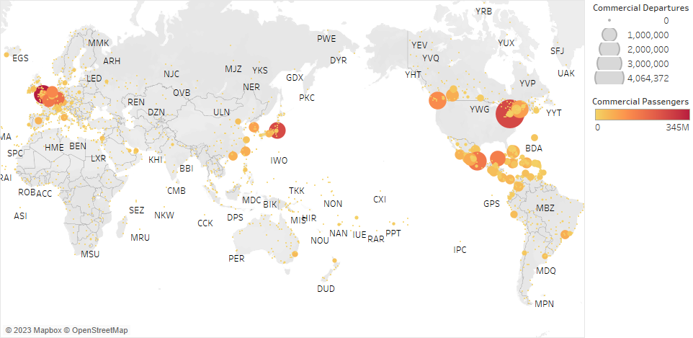
Top world airports with the highest number of departures and passengers from 1990 to 2022
LHR - London - Heathrow, UK
YYZ - Toronto, Canada
NRT - Tokyo - Narita, Japan
FRA - Frankfurt Main, Germany
CDG - Paris - Charles de Gaulle, France
Notes:
On the other hand the world top 5 airports with highest number of departures and passengers are

Slide 20
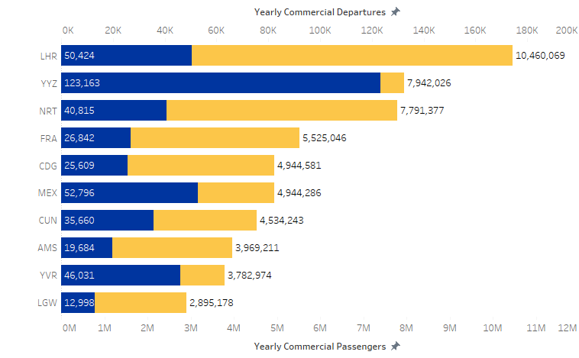

Top world airports with the highest number of passengers and their corresponding number of departures per year from 1990 to 2022
LHR - London - Heathrow, UK
YYZ - Toronto, Canada
NRT - Tokyo - Narita, Japan
FRA - Frankfurt Main, Germany
CDG - Paris - Charles de Gaulle, France
MEX - Mexico City Int’l, Mexico
CUN - Cancun, Mexico
AMS - Amsterdam, Netherlands
YVR - Vancouver Int’l, Canada
LGW - London - Gatwick, UK
Notes:
Top non-US airport LHR can reach up to 10.5M passengers per year with 50K departures per year; YYZ has the highest departures (123K/year) but only 2nd in terms of number of passengers; NRT can fly around the same number of passengers as YYZ with fewer departures; MEX has the 2nd highest number of departures but on 6th spot in terms of number of passengers.

Slide 21
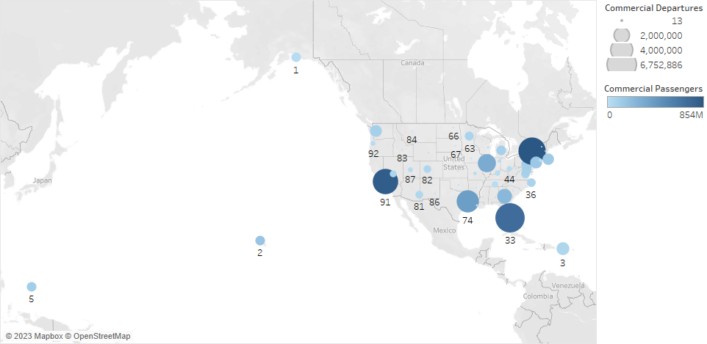
Top US areas with the highest number of departures and passengers from 1990 to 2022
22 - New York
91 - California
33 - Florida
74 - Texas
41 - Illinois

Slide 22
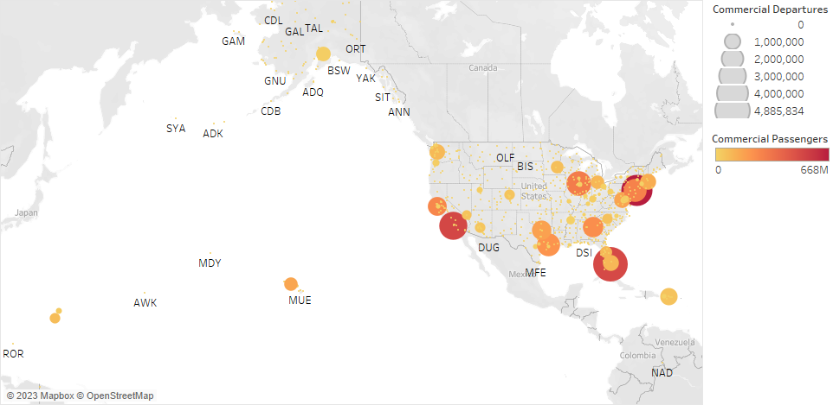
Top US airports with the highest number of departures and passengers from 1990 to 2022
JFK - John F. Kennedy, NY
LAX - Los Angeles, CA
MIA - Miami, FL
ORD - Chicago - O’Hare, IL
EWR - New York - Newark, NJ

Slide 23
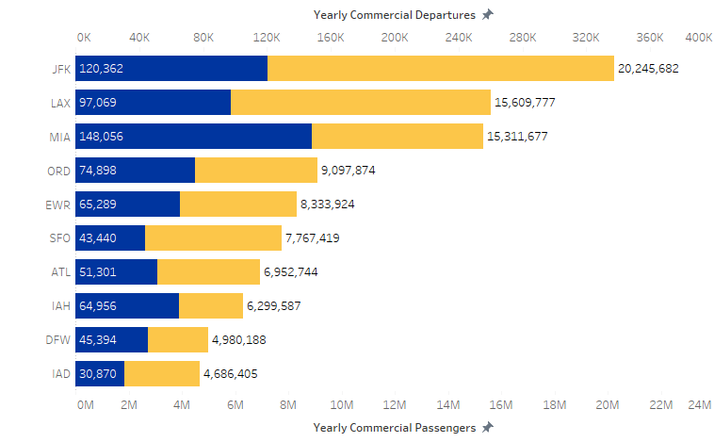
Top US airports with the highest number of passengers and their corresponding number of departures per year from 1990 to 2022
JFK - John F. Kennedy, NY
LAX - Los Angeles, CA
MIA - Miami, FL
ORD - Chicago - O’Hare, IL
EWR - New York - Newark, NJ
SFO - San Francisco, CA
ATL - Atlanta - Hartsfield, GA
IAH - Houston - George Bush, TX
DFW - Dallas - Fort Worth, TX
IAD - Washington DC - Dulles
Notes:
Top US airport JFK can reach up to 20M passengers per year with 120K departures per year; MIA has the highest departures (148K/year) but only 3rd in terms of number of passengers; LAX can fly more passengers than MIA with only 100K departures per year; Top 3 airports with the most flights also have the most passengers.

Slide 24
TOP CARRIER
COMPETITORS

Slide 25





Top 5 carriers with the highest number of passengers for the past 5 years
Top 5 Carriers on 2018-2022
Airline | Annual Passengers | Market Share
AA | 22.97M | 13.9%
UA | 20.55M | 12.4%
DL | 17.59M | 10.6%
B6 | 7.38M | 4.5%
BA | 4.68M | 2.8%
Total | 73.17M | 44.2%
Annual Average Flights (2018-2022): 165.37M
Notes:
Top 5 carriers fly 44.2% of commercial passengers -- flying a total of 73.17M passengers per year out of the 165.37M average passengers per year for the past 5 years

Slide 26
THANK YOU

